Slide 1
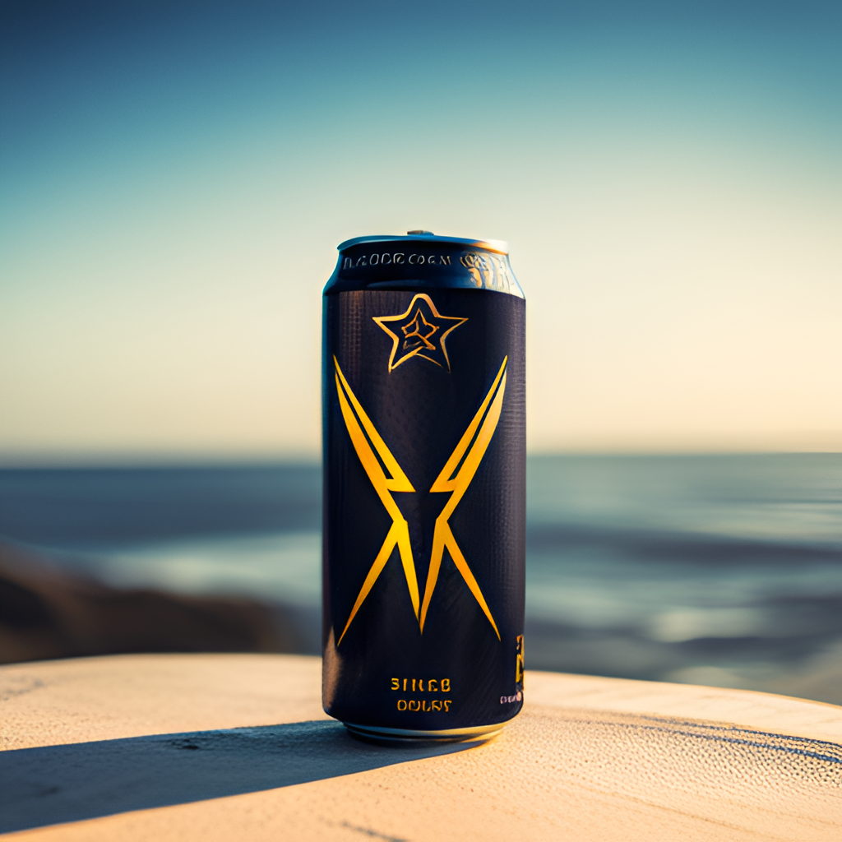
Energizing India: CodeX’s Journey to Dominate the Indian Energy Drink Market
Created By
Chijindu Okafor

Slide 2
Why? – Objectives
What? – Company profile
How? – Dataset, Ask & Tools Used

Slide 3
Why? - Objectives of Report
﻿Codex is a German beverage company that is aiming to make its mark in the Indian market. A few months ago, they launched their energy drink in 10 cities in India.
Their Marketing team is responsible for increasing :
Brand awareness
Market share
Product development
A survey was carried out in ten cities, and 10,000 respondents provided their responses. Peter Pandey, a marketing data analyst, has been assigned the responsibility of transforming these survey results into valuable insights that the team can utilize to make informed decisions.

Slide 4
What? – Company Details
CodeX, a German beverage company, has introduced its energy drink in 10 cities across India.

Slide 5
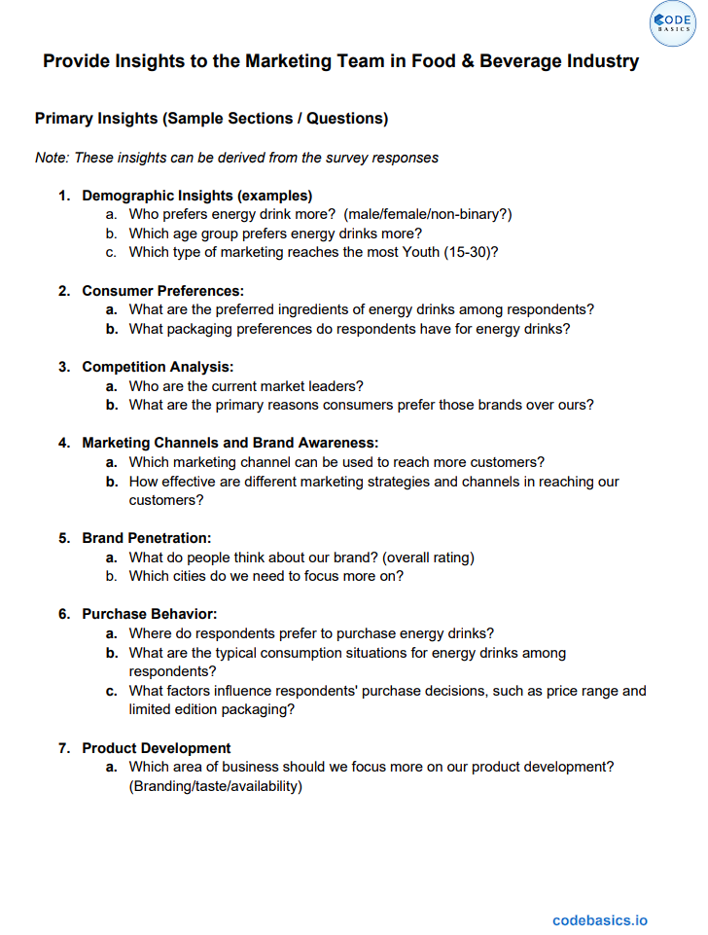
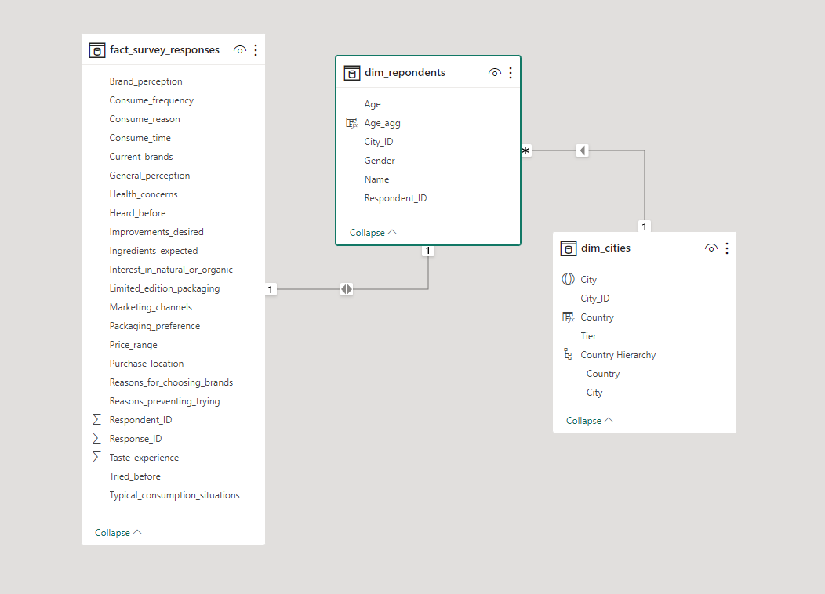


How? – Dataset, Ask & Tools Used
For analysis & Visualization

Slide 6
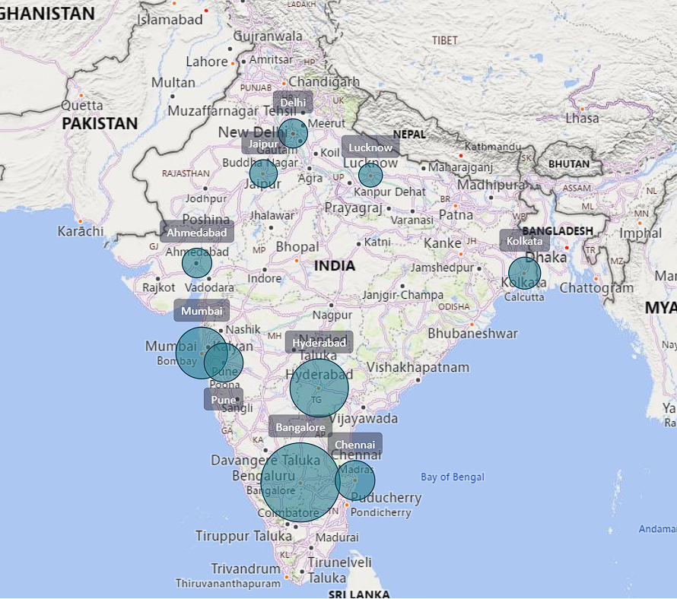
Companies Market

Slide 7

Demographic Insights
Who prefers energy drink more? (male/female/non-binary?)
Which age group prefers energy drinks more?
Which type of marketing reaches the most Youth (15-30)?

Slide 8
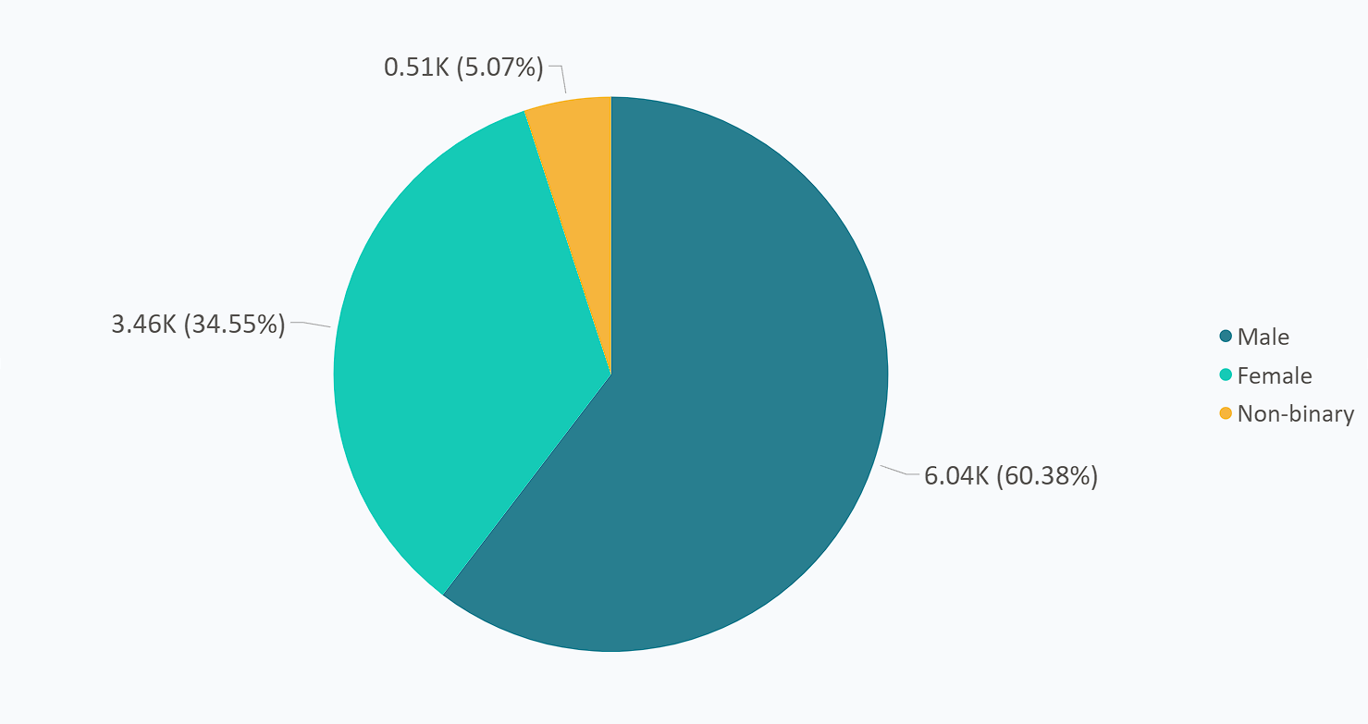
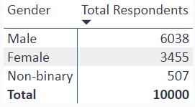
Who prefers Energy drinks more?
Males exhibit a preference for energy drinks that is nearly doubshownle the preference by females.

Slide 9
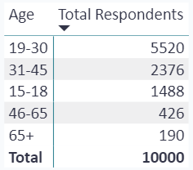

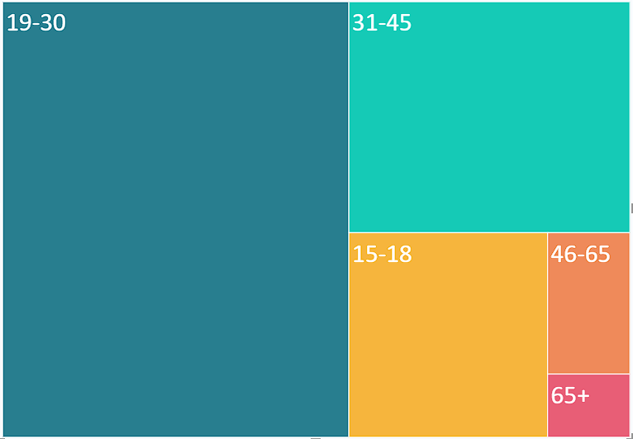
Which age group prefers energy drinks more?
The 19-30 age group prefers energy drinks more due to busy work schedules, sports activities, and other factors.

Slide 10
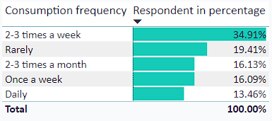
What is the consumption frequency of the respondents?
Respondents with 2-3 times a week had 34.91%, daily 13.46%, once a week 16.09%, 2-3 times a month 16.13%, and rarely 19.41%.

Slide 11
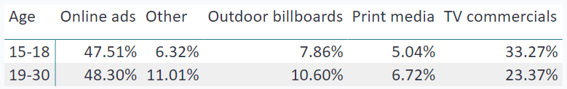
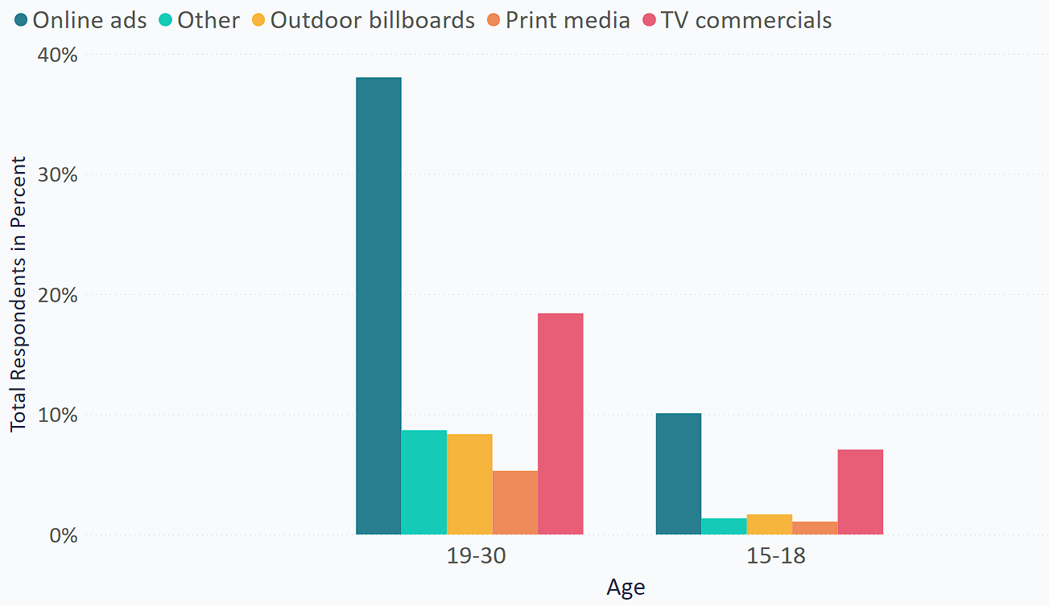
Which type of marketing reaches the most Youth (15-30)?
Online ads & TV reach the 15-30 age group best due to their high engagement with mobile devices and social media.

Slide 12

Consumer Preferences
What are the preferred ingredients of energy drinks among respondents?
What packaging preferences do respondents have for energy drinks?

Slide 13
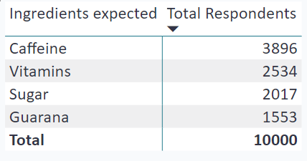
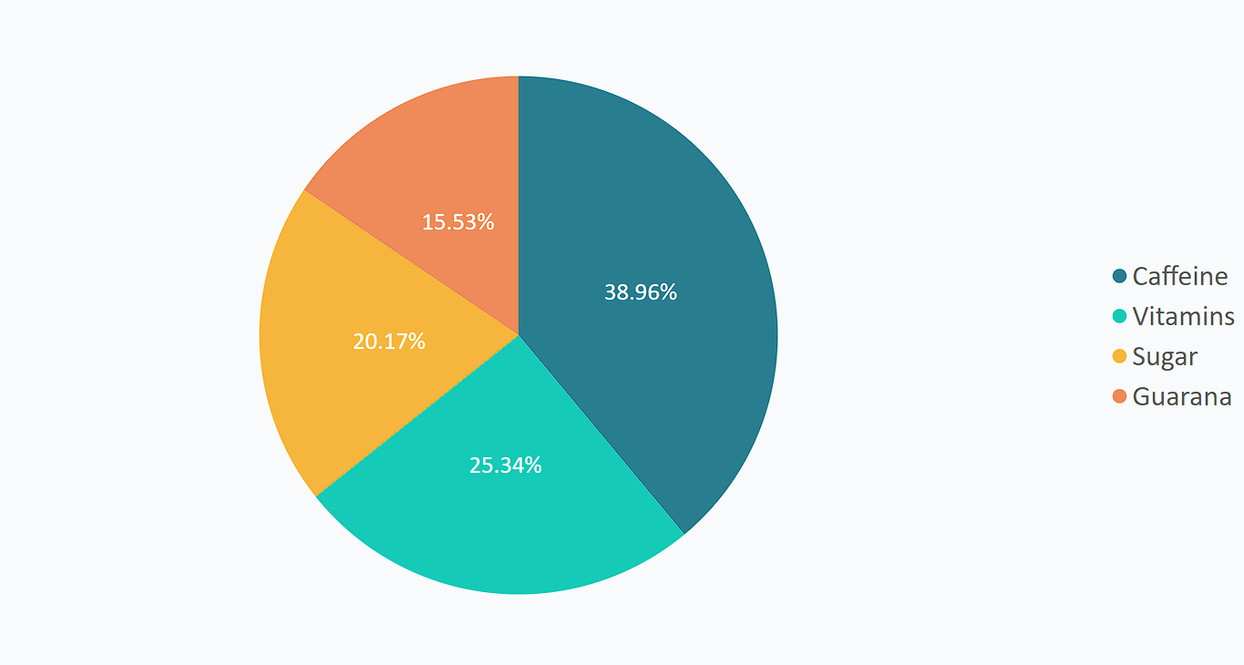
What are the preferred ingredients of energy drinks among respondents?
Caffeine stands as the most preferred ingredient, providing a temporary energy boost and even enhancing mood among consumers.

Slide 14
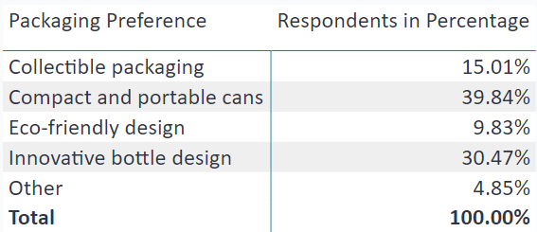
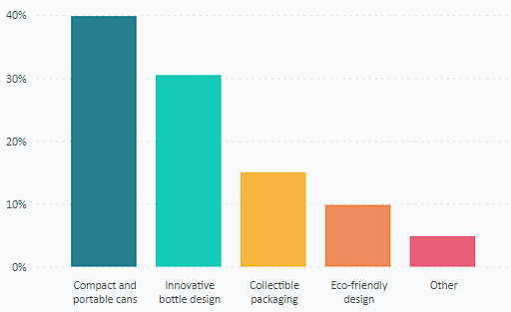
What packaging preferences do respondents have for energy drinks?
The majority of respondents (39.84%) prefer "Compact and portable cans" for energy drink packaging, indicating a strong demand for convenient and on-the-go options.
Notes:
Respondents show a strong preference for "Compact and portable cans," with nearly 40% of them favoring this packaging option for energy drinks.
"Innovative bottle design" is also popular, capturing the interest of approximately 30.47% of respondents.
A notable 15.01% of respondents prefer "Collectible packaging," indicating an attraction to unique and collectible elements in packaging.
"Eco-friendly design" appeals to about 9.83% of respondents, highlighting a significant interest in environmentally conscious packaging options.
A smaller segment of respondents (4.85%) indicated a preference for "Other" packaging, suggesting potential room for exploration and diverse packaging solutions.

Slide 15
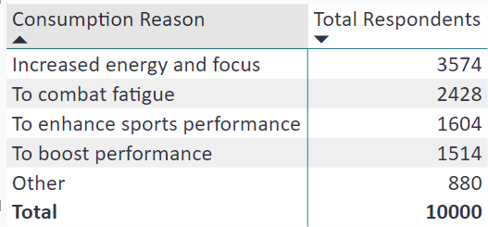
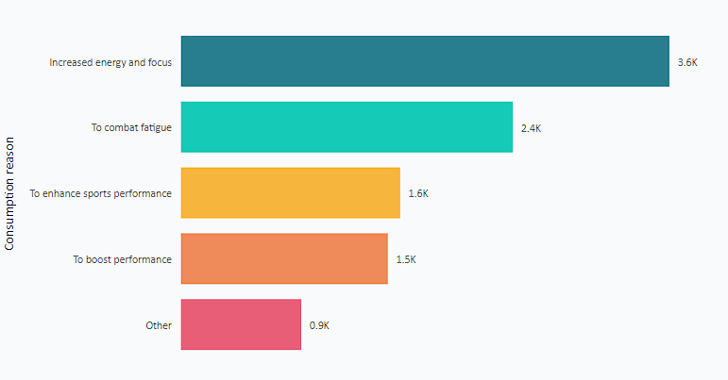
Why do the respondents consume energy drinks?
The primary reason for consuming energy drinks is to achieve "Increased energy and focus," as indicated by the highest number of respondents (3,574), emphasizing the demand for enhanced alertness and concentration.
Notes:
"Increased energy and focus" is the primary reason for consuming energy drinks, with the highest number of respondents at 3,574, indicating a strong demand for improved alertness and concentration.
"To combat fatigue" ranks second, with 2,428 respondents seeking energy drinks to fight tiredness and boost their energy levels.
"To enhance sports performance" follows with 1,604 respondents, suggesting a significant interest in using energy drinks for athletic and physical activities.
"To boost performance" is a close fourth, with 1,514 respondents seeking energy drinks to enhance their overall performance.
A portion of respondents (880) cited "Other" reasons, indicating a potential range of motivations beyond the listed options.

Slide 16

Competition Analysis
Who are the current market leaders?
What are the primary reasons consumers prefer those brands over ours?

Slide 17

Who are the current market leaders?

Slide 18
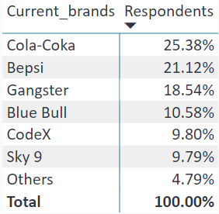
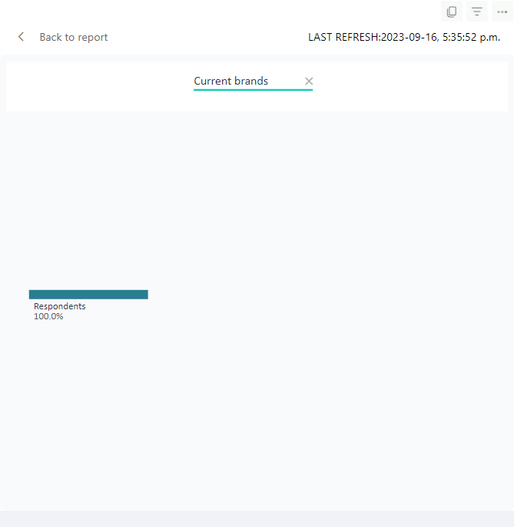
"Cola-Coka" leads the market with the highest number of respondents (2,538), establishing its dominant position among energy drink brands.
Notes:
Among the current market leaders in the energy drink industry, "Cola-Coka" stands out with the highest number of respondents at 2,538, reflecting a significant market presence.
"Bepsi" follows closely behind with 2,112 respondents, showcasing a strong position as one of the top competitors in the market.
"Gangster" secures a substantial share with 1,854 respondents, indicating a considerable following among energy drink consumers.
"Blue Bull" holds a competitive position with 1,058 respondents, contributing to the market leadership landscape.
"CodeX" has a noteworthy presence with 980 respondents, demonstrating a competitive position in the energy drink market.
"Sky 9" captures a significant portion with 979 respondents, highlighting its influence as a market leader.
"Others" encompass various brands, indicating a diverse market landscape beyond the listed options.

Slide 19
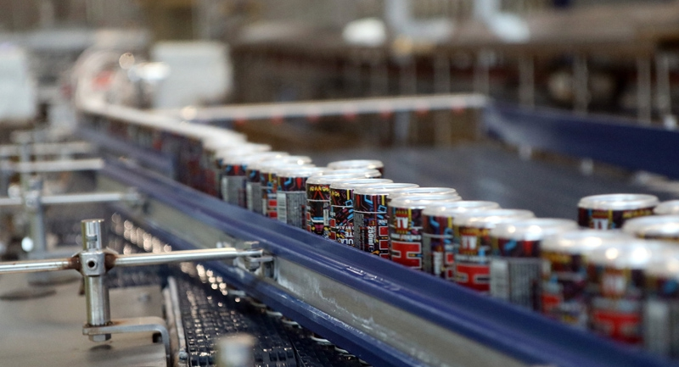
What are the primary reasons consumers prefer those brands over ours?

Slide 20
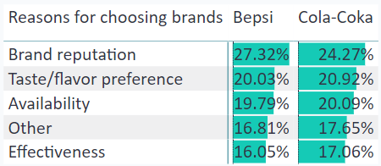
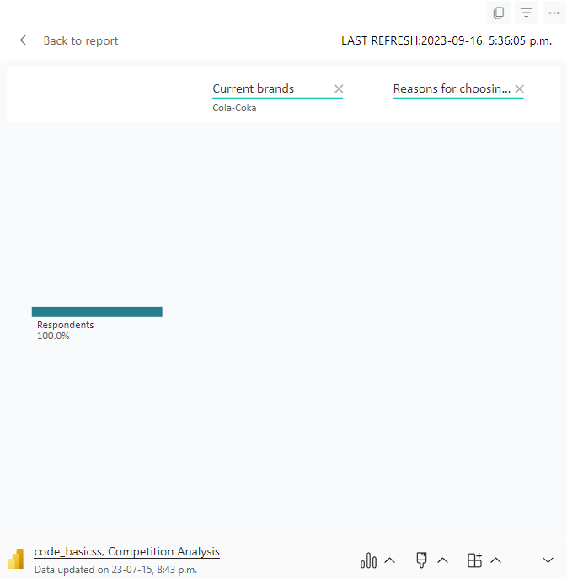
The primary reason consumers prefer "Cola-Coka" over our brand is its strong brand reputation, favored by 616 respondents, highlighting its appeal and trustworthiness in the market.
Notes:
The primary reasons consumers prefer "Cola-Coka" over our brand include its high availability, strong brand reputation, and perceived effectiveness, as indicated by significant respondent counts of 510, 616, and 433, respectively.
For "Bepsi," brand reputation, availability, and taste/flavor preference play crucial roles, with 577, 418, and 423 respondents expressing preference for these attributes, respectively.
"Blue Bull" attracts consumers through its brand reputation (289 respondents) and taste/flavor preference (237 respondents).
In the case of our brand "CodeX," taste/flavor preference (182 respondents) and brand reputation (176 respondents) appear to be key drivers for consumer preference.
"Gangster" gains favor among consumers due to its brand reputation (511 respondents) and availability (339 respondents).
The category "Others" has a relatively even distribution across the primary reasons, with availability (140 respondents) and taste/flavor preference (87 respondents) being notable factors.

Slide 21
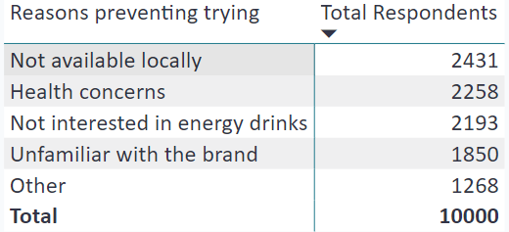
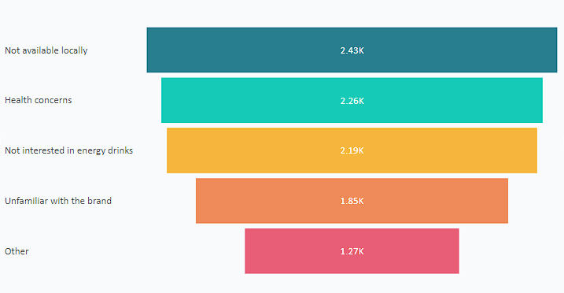
What factors are preventing respondents from trying CodeX?
The primary factor preventing respondents from trying CodeX is its limited availability locally, with 2,431 respondents expressing concerns about accessibility.
Notes:
The most significant factor preventing respondents from trying CodeX is its limited availability locally, as indicated by 2,431 respondents, suggesting a potential need for improved distribution and accessibility.
Health concerns rank second, with 2,258 respondents expressing reservations about trying CodeX due to potential health-related issues, emphasizing the importance of addressing these concerns and promoting the product's safety.
A notable number of respondents (2,193) stated disinterest in energy drinks altogether, suggesting the need for targeted marketing efforts to attract this segment.
Approximately 1,850 respondents reported being unfamiliar with the CodeX brand, indicating an opportunity for enhanced brand awareness and recognition.
A substantial portion of respondents (1,268) cited "Other" reasons, necessitating further investigation to understand specific barriers that may be hindering their interest in trying CodeX.

Slide 22
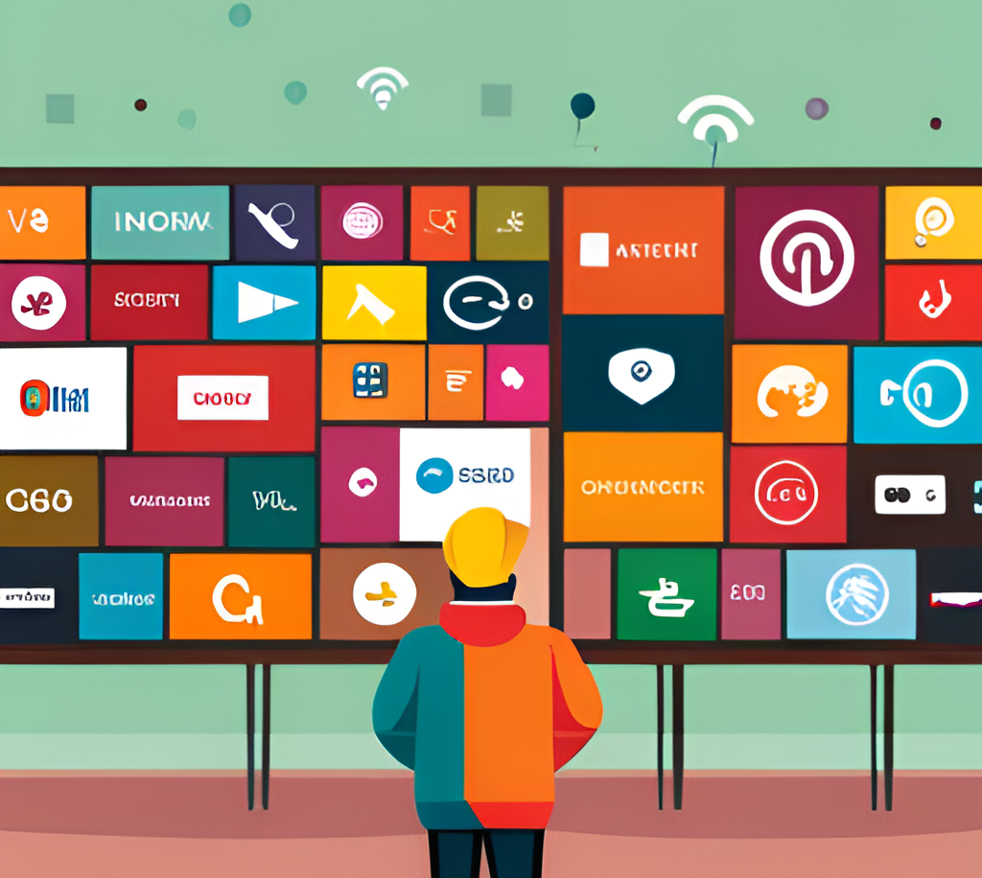
Marketing Channels and Brand Awareness
Which marketing channel can be used to reach more customers?
How effective are different marketing strategies and channels in reaching our customers?

Slide 23
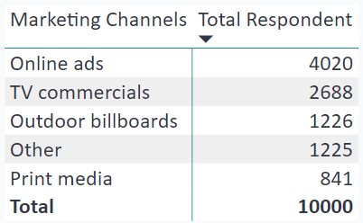
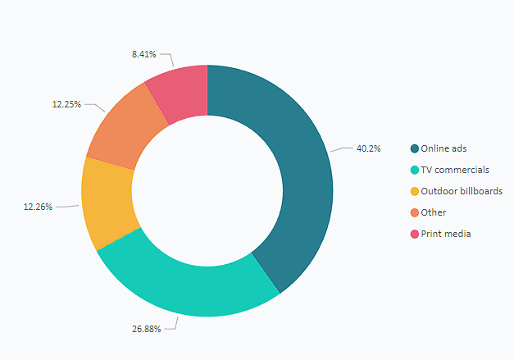
Which marketing channel can be used to reach more customers?
Online ads prove to be the most effective marketing channel for reaching more customers, with 4,020 respondents showing its potential to engage a broader audience and boost brand awareness.
Notes:
- Online ads are the most effective marketing channel to reach more customers, with 4,020 respondents indicating its potential to capture a broader audience and increase brand visibility.
- TV commercials also prove to be a powerful marketing channel, with 2,688 respondents showing their potential reach and impact on target customers.
- Outdoor billboards present another viable option, with 1,226 respondents acknowledging their effectiveness in reaching a larger audience.
- A considerable number of respondents (1,225) cited "Other" marketing channels, suggesting the need for exploration and innovation to identify additional effective channels.
- Print media, though less preferred, still garnered interest from 841 respondents, highlighting its relevance in specific marketing strategies.

Slide 24
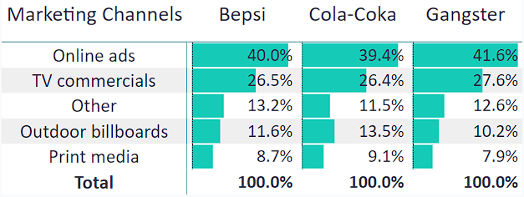
How effective are different marketing strategies and channels in reaching our customers?
"Online ads" and "TV commercials" are the most effective marketing strategies for reaching customers among the current market leaders, with response rates ranging from 26.36% to 41.64%.
Notes:
Among the current market leaders, "Online ads" have proven to be consistently effective in reaching customers, with Bepsi, Cola-Coka, and Gangster all showing high response rates ranging from 39.44% to 41.64%.
"TV commercials" also demonstrate effectiveness, garnering significant response rates of 26.36% to 27.62% among the same market leaders.
While "Outdoor billboards" and "Print media" still receive notable responses, "Online ads" and "TV commercials" remain the most impactful marketing strategies for engaging customers among these brands.

Slide 25

Brand Penetration
What do people think about our brand?
Which cities do we need to focus more on?

Slide 26
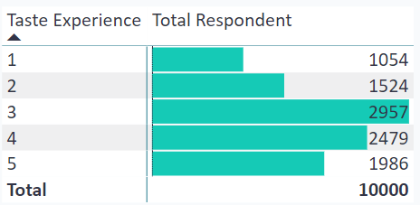
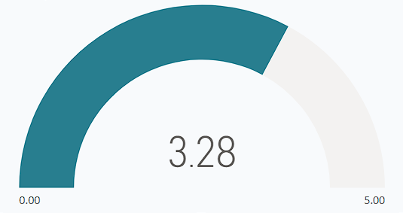
What do people think about the taste?
The taste of the energy drink receives positive feedback from the majority of respondents, with 2,957 of them giving it an average or satisfactory rating of "3," indicating overall satisfaction with the product's taste.
Notes:
The taste experience of the energy drink is generally positive, as indicated by a significant number of respondents (2,957) rating it as "3," signifying an average or satisfactory taste.
Additionally, a substantial portion of respondents (2,479) provided a rating of "4," implying a good taste experience, further supporting the overall positive perception of the product's taste.
Although some respondents (1,054) rated the taste as "1" or "2," indicating room for improvement, the majority of feedback suggests that the taste is well-received by a considerable portion of the target audience.

Slide 27
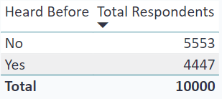
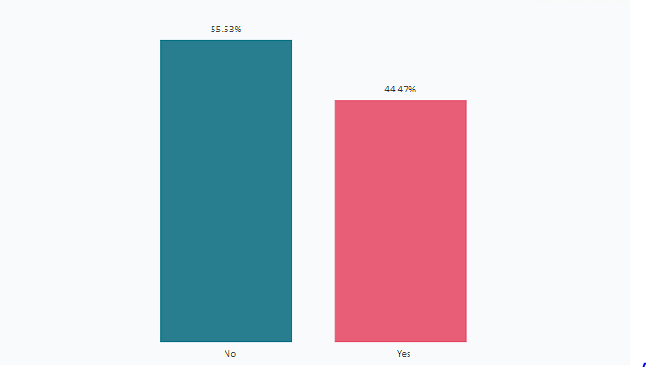
Who has heard of CodeX?
CodeX has garnered brand awareness among 44.47% of respondents, demonstrating a promising level of recognition within the target audience.
Notes:
A significant portion of respondents, 44.47%, have heard of CodeX, indicating a substantial level of brand awareness in the market.
However, it's noteworthy that a considerable number of respondents (55.53%) have not yet heard of CodeX, suggesting the potential for increased marketing efforts to expand brand recognition further.

Slide 28
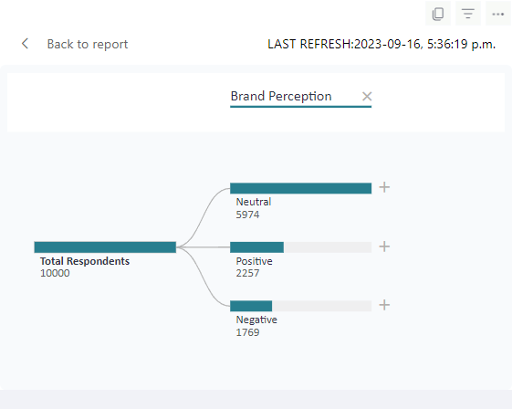
What do people think about our brand?
- The brand perception among respondents is predominantly "Neutral" at 59.74%, indicating potential for refining and reinforcing CodeX's brand image to create stronger emotional connections.
Notes:
- The majority of respondents, 59.74%, hold a "Neutral" perception of the brand, suggesting an opportunity for CodeX to establish a stronger and more distinct brand identity.
- Notably, 22.57% of respondents view the brand in a "Positive" light, while 17.69% have a "Negative" perception, indicating room for improvement in shaping the overall brand sentiment.

Slide 29
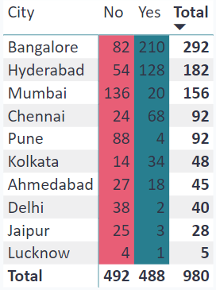
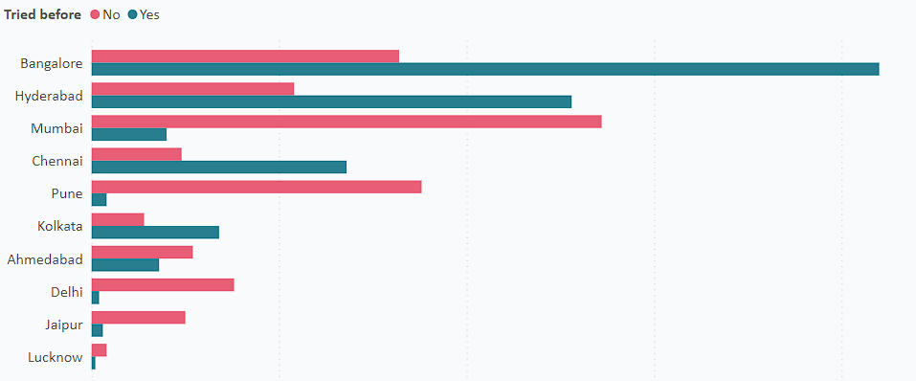
Which cities do we need to focus more on?
Key cities for CodeX expansion: Bangalore, Hyderabad, and Chennai exhibit higher positive responses ("Yes") than negative responses ("No"), indicating strong potential and demand for the product.
Notes:
The data suggests that cities like Bangalore, Chennai, Hyderabad, and Pune exhibit a notable level of awareness and interest in CodeX, as indicated by the "Yes" responses significantly outweighing the "No" responses. These cities seem primed for targeted marketing efforts, focusing on reinforcing CodeX's presence and catering to the existing enthusiasm. Conversely, cities such as Delhi and Kolkata, although showing a lower proportion of "Yes" responses, still present a valuable opportunity for brand expansion, as even a moderate increase in awareness could yield promising results. A strategic approach that tailors campaigns to the specific preferences and interests of each city can effectively nurture interest and accelerate CodeX's growth in these markets.

Slide 30

Purchase Behavior
Where do respondents prefer to purchase energy drinks?
What are the typical consumption situations for energy drinks among respondents?
What factors influence respondents' purchase decisions, such as price range and limited edition packaging?

Slide 31
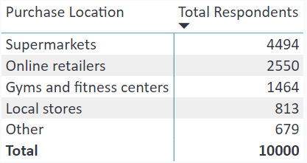
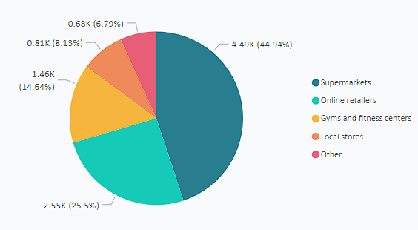
Where do respondents prefer to purchase energy drinks?
Preferred Purchase Locations: Supermarkets stand out as the most favored choice, capturing 44.94% of respondents' preferences for buying energy drinks.
Notes:
Preferred Purchase Locations: Respondents overwhelmingly opt for supermarkets, with 44.94% of them choosing this convenient option. Online retailers and gyms also garner significant interest at 25.5% and 14.64%, respectively.

Slide 32
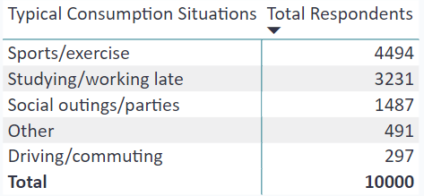
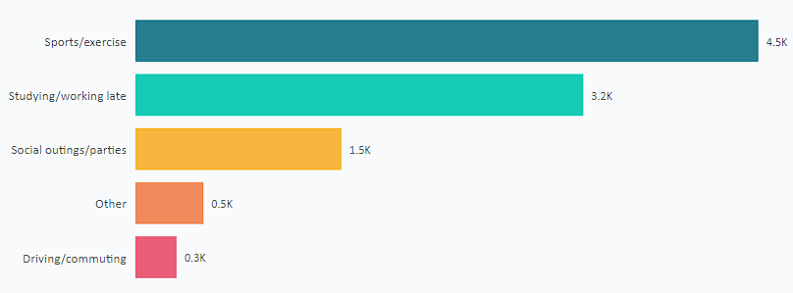
What are the typical consumption situations for energy drinks among respondents?
Typical Consumption Situations: Majority of respondents (44.94%) consume energy drinks during sports/exercise, reflecting an active lifestyle preference.
Notes:
Typical Consumption Situations: Respondents commonly consume energy drinks during sports/exercise (44.94%), followed by studying/working late (32.31%) and social outings/parties (14.87%).

Slide 33
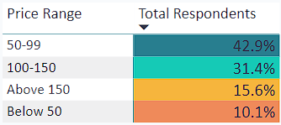
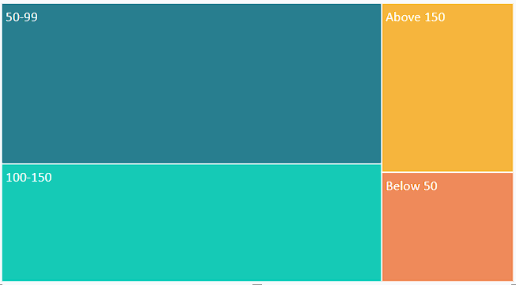
What factors influence respondents' purchase decisions?
Price Range Impact: The price range of 50-99 significantly influences respondents' purchase decisions, driving the choice of energy drinks for 42.88% of them.
Notes:
Price Range Influence: The price range of 50-99 is the most influential factor in respondents' purchase decisions, with 42.88% of respondents considering it when choosing energy drinks.

Slide 34
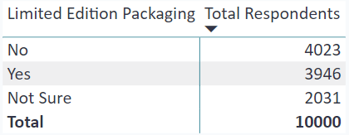
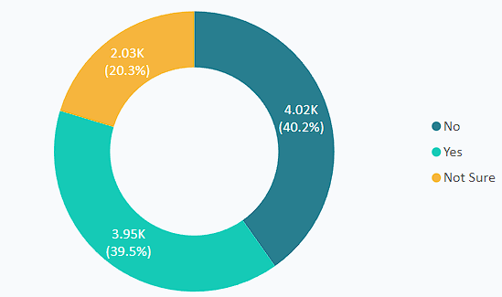
What factors influence respondents' purchase decisions?
Appealing Packaging: Limited edition packaging holds sway over respondents' purchase decisions, with 39.46% indicating a preference for this unique and attractive feature.
Notes:
Limited Edition Packaging Appeal: A substantial 39.46% of respondents express a clear preference for energy drink options with limited edition packaging, highlighting its impact on purchase decisions.

Slide 35

Product Development
Which area of business should we focus more on our product development? (Branding/taste/availability)
Taste
Availability
Branding

Slide 36
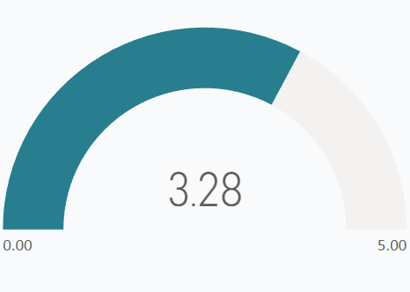
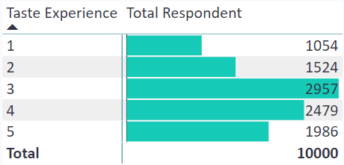
Taste
Refining Taste: Taste is a significant factor, with 29.57% of respondents rating it as 3, suggesting a key area for product development to enhance flavor satisfaction.
Notes:
Enhancing Taste Experience: The majority of respondents value taste, with 29.57% favoring a taste rating of 3, indicating that focusing on refining the flavor profile could significantly impact product development and customer satisfaction.

Slide 37
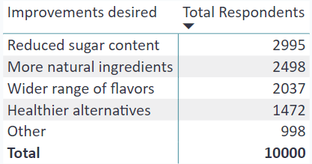
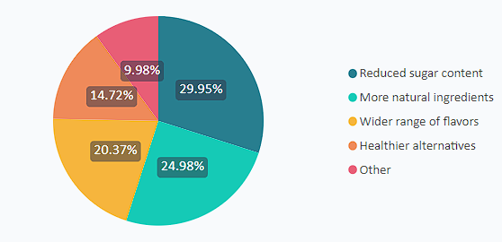
Taste
Taste Focus: Respondents prioritize taste enhancements, with 29.95% aiming for reduced sugar and 24.98% seeking more natural ingredients, reflecting a demand for healthier and appealing options.
Notes:
Health-Conscious Improvements: Respondents show a desire for healthier options, with 29.95% seeking reduced sugar content and 24.98% desiring more natural ingredients, indicating a focus on taste while maintaining healthier attributes in product development.

Slide 38
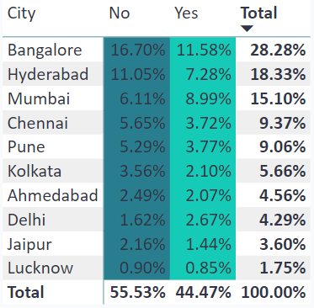
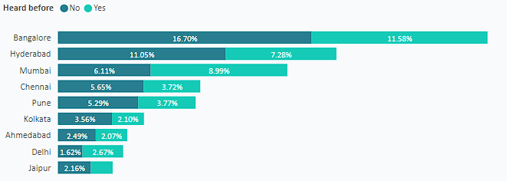
Availability
Availability Priority: Widespread availability is crucial, notably in cities like Bangalore (16.70%) and Hyderabad (11.05%), where interest increases when availability is highlighted.
Notes:
Availability Emphasis: Ensuring widespread availability appears pivotal, with cities like Bangalore (16.70%) and Hyderabad (11.05%) exhibiting interest when availability is communicated, indicating a need to focus on increasing product visibility in these regions.

Slide 39
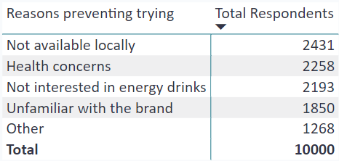

Availability
Availability Focus: Addressing the issue of "Not available locally" (2431 respondents) can potentially open up a significant market segment.
Notes:
Considering Product Development:
Availability Emphasis: Addressing the challenge of "Not available locally" (2431 respondents) could lead to a substantial market expansion. Focusing on increasing product accessibility might significantly enhance CodeX's reach and penetration.

Slide 40

Branding
Branding Focus: Respondents' positive reception of "Limited Edition Packaging" (3946) indicates an opportunity to enhance brand recognition through eye-catching design choices.
Notes:
**Branding Focus**: A considerable portion of respondents (3946) expressing interest in "Limited Edition Packaging" suggests that investing in unique and eye-catching packaging could boost brand recognition and appeal. This avenue could enhance CodeX's branding efforts and potentially attract more customers.

Slide 41

Secondary Insights
What are the consumption frequencies of the respondents by their age groups?

Slide 42


What are the consumption frequencies of the respondents by their age groups?
**Age & Consumption Frequency**: Respondents aged 19-30 show the highest energy drink consumption, particularly 2-3 times a week (1917), followed by the 15-18 age group, also preferring 2-3 times a week (539).
Notes:
**Age & Consumption Frequency**: Respondents aged 19-30 exhibit higher consumption frequency, with 2-3 times a week being most common (1917). Among 15-18 age group, 2-3 times a week is also prominent (539), while 46-65 age group has relatively lower consumption across all frequencies.

Slide 43

Recommendations for CodeX
Improving taste by the respondents’ improvement desire
Increasing product availability in specific cities
Specific Marketing based on marketing channel insights and purchase location
Introducing brand ambassadors

Slide 44
Improving taste by the respondents’ improvement desire
**Taste Upgrade Needs**: Respondents seek improved taste with less sugar, natural ingredients, wider flavor choices, and healthier options to enhance CodeX energy drinks' appeal.
**Taste Enhancement**: Respondents desire improved taste across all levels, with a significant interest shown by those at taste experience levels 3, 4, and 5.
Notes:
**Taste Enhancement**: Respondents' desire for taste improvement is evident across all taste experiences. Notably, the majority of respondents with taste experience levels 3 (2957) and 4 (2479) express an interest in improved taste for CodeX energy drinks.
**Enhancing Taste Preferences**: Respondents express a strong desire for improved taste, primarily focused on reduced sugar content, more natural ingredients, and a wider range of flavors. The potential for offering healthier alternatives is also a key consideration.

Slide 45
Increasing product availability in specific cities
**City Expansion Focus**: Target cities like Bangalore, Hyderabad, Mumbai, and Chennai, where a notable portion of respondents express interest in CodeX after hearing about it, indicating potential growth opportunities.
Notes:
**City Expansion Focus**: To enhance reach, concentrate on cities like Bangalore, Hyderabad, Mumbai, and Chennai, where a considerable percentage of respondents are unfamiliar with CodeX but express interest after hearing about it.

Slide 46

Specific Marketing based on marketing channel insights and purchase location
**Effective Channels**: Utilize online ads and TV commercials as primary marketing channels, while also considering outdoor billboards and print media for a well-rounded approach.
**Targeted Marketing**: Focus on supermarkets and online retailers, with strong potential in gyms and local stores too.
Notes:
**Strategic Marketing**: Prioritize marketing efforts in supermarkets and online retailers, which have the highest respondent concentration. Also, consider tailored campaigns for gyms and fitness centers due to their substantial interest.
Strategic Marketing Channels: To maximize reach and engagement, it's recommended to focus on online ads and TV commercials as these channels garnered substantial attention from respondents. Additionally, incorporating outdoor billboards and print media can enhance brand visibility and engage a diverse audience, ensuring a comprehensive and impactful marketing strategy.

Slide 47

Introducing brand ambassadors
**Leveraging Ambassadors**: Engaging brand ambassadors can capitalize on positive and neutral perceptions of CodeX, boosting credibility and recognition.
Notes:
**Empowering Brand Ambassadors**: Leveraging brand ambassadors could significantly impact brand perception. With a considerable number of respondents having a neutral perception and a positive perception of CodeX, introducing relatable and influential brand ambassadors can help sway perceptions towards a more positive note, enhancing brand credibility and recognition.

Slide 48

Virat Kohli
Name | Industry Influence | Social Media Followers | Previous Brand Associations | Relevance to Target Audience | Potential Benefits for CodeX
Virat Kohli | Cricket / Sports | 100M+ (across platforms) | Puma, Audi, Myntra, Wrogn | Youth, Fitness Enthusiasts | Increased Brand Awareness, Connect with Sports Enthusiasts
Deepika Padukone | Bollywood / Entertainment | 50M+ (across platforms) | L'Oreal, Tanishq, Nike | Youth, Fashion & Lifestyle | Enhanced Brand Appeal, Wider Female Audience Reach
Ranveer Singh | Bollywood / Entertainment | 40M+ (across platforms) | Adidas, Kansai Nerolac | Youth, Trendsetters | Energizing Brand Image, Youth Appeal
PV Sindhu | Badminton / Sports | 10M+ (across platforms) | JBL, Panasonic | Sports Enthusiasts | Brand Association with Success, Inspiration to Athletes
Bhumi Pednekar | Bollywood / Environment | 15M+ (across platforms) | Dabur, Pepsi | Environment-conscious audience | Sustainability & Health Focus, Female Empowerment

Slide 49

Deepika Padukone
Name | Industry Influence | Social Media Followers | Previous Brand Associations | Relevance to Target Audience | Potential Benefits for CodeX
Virat Kohli | Cricket / Sports | 100M+ (across platforms) | Puma, Audi, Myntra, Wrogn | Youth, Fitness Enthusiasts | Increased Brand Awareness, Connect with Sports Enthusiasts
Deepika Padukone | Bollywood / Entertainment | 50M+ (across platforms) | L'Oreal, Tanishq, Nike | Youth, Fashion & Lifestyle | Enhanced Brand Appeal, Wider Female Audience Reach
Ranveer Singh | Bollywood / Entertainment | 40M+ (across platforms) | Adidas, Kansai Nerolac | Youth, Trendsetters | Energizing Brand Image, Youth Appeal
PV Sindhu | Badminton / Sports | 10M+ (across platforms) | JBL, Panasonic | Sports Enthusiasts | Brand Association with Success, Inspiration to Athletes
Bhumi Pednekar | Bollywood / Environment | 15M+ (across platforms) | Dabur, Pepsi | Environment-conscious audience | Sustainability & Health Focus, Female Empowerment

Slide 50

Ranveer Singh
Name | Industry Influence | Social Media Followers | Previous Brand Associations | Relevance to Target Audience | Potential Benefits for CodeX
Virat Kohli | Cricket / Sports | 100M+ (across platforms) | Puma, Audi, Myntra, Wrogn | Youth, Fitness Enthusiasts | Increased Brand Awareness, Connect with Sports Enthusiasts
Deepika Padukone | Bollywood / Entertainment | 50M+ (across platforms) | L'Oreal, Tanishq, Nike | Youth, Fashion & Lifestyle | Enhanced Brand Appeal, Wider Female Audience Reach
Ranveer Singh | Bollywood / Entertainment | 40M+ (across platforms) | Adidas, Kansai Nerolac | Youth, Trendsetters | Energizing Brand Image, Youth Appeal
PV Sindhu | Badminton / Sports | 10M+ (across platforms) | JBL, Panasonic | Sports Enthusiasts | Brand Association with Success, Inspiration to Athletes
Bhumi Pednekar | Bollywood / Environment | 15M+ (across platforms) | Dabur, Pepsi | Environment-conscious audience | Sustainability & Health Focus, Female Empowerment

Slide 51

PV Sindhu
Name | Industry Influence | Social Media Followers | Previous Brand Associations | Relevance to Target Audience | Potential Benefits for CodeX
Virat Kohli | Cricket / Sports | 100M+ (across platforms) | Puma, Audi, Myntra, Wrogn | Youth, Fitness Enthusiasts | Increased Brand Awareness, Connect with Sports Enthusiasts
Deepika Padukone | Bollywood / Entertainment | 50M+ (across platforms) | L'Oreal, Tanishq, Nike | Youth, Fashion & Lifestyle | Enhanced Brand Appeal, Wider Female Audience Reach
Ranveer Singh | Bollywood / Entertainment | 40M+ (across platforms) | Adidas, Kansai Nerolac | Youth, Trendsetters | Energizing Brand Image, Youth Appeal
PV Sindhu | Badminton / Sports | 10M+ (across platforms) | JBL, Panasonic | Sports Enthusiasts | Brand Association with Success, Inspiration to Athletes
Bhumi Pednekar | Bollywood / Environment | 15M+ (across platforms) | Dabur, Pepsi | Environment-conscious audience | Sustainability & Health Focus, Female Empowerment

Slide 52

Bhumi Pednekar
Name | Industry Influence | Social Media Followers | Previous Brand Associations | Relevance to Target Audience | Potential Benefits for CodeX
Virat Kohli | Cricket / Sports | 100M+ (across platforms) | Puma, Audi, Myntra, Wrogn | Youth, Fitness Enthusiasts | Increased Brand Awareness, Connect with Sports Enthusiasts
Deepika Padukone | Bollywood / Entertainment | 50M+ (across platforms) | L'Oreal, Tanishq, Nike | Youth, Fashion & Lifestyle | Enhanced Brand Appeal, Wider Female Audience Reach
Ranveer Singh | Bollywood / Entertainment | 40M+ (across platforms) | Adidas, Kansai Nerolac | Youth, Trendsetters | Energizing Brand Image, Youth Appeal
PV Sindhu | Badminton / Sports | 10M+ (across platforms) | JBL, Panasonic | Sports Enthusiasts | Brand Association with Success, Inspiration to Athletes
Bhumi Pednekar | Bollywood / Environment | 15M+ (across platforms) | Dabur, Pepsi | Environment-conscious audience | Sustainability & Health Focus, Female Empowerment

